Slide 1
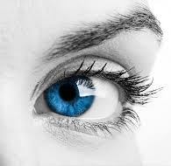
Philosophy
The Love of
Following Reason

Slide 2
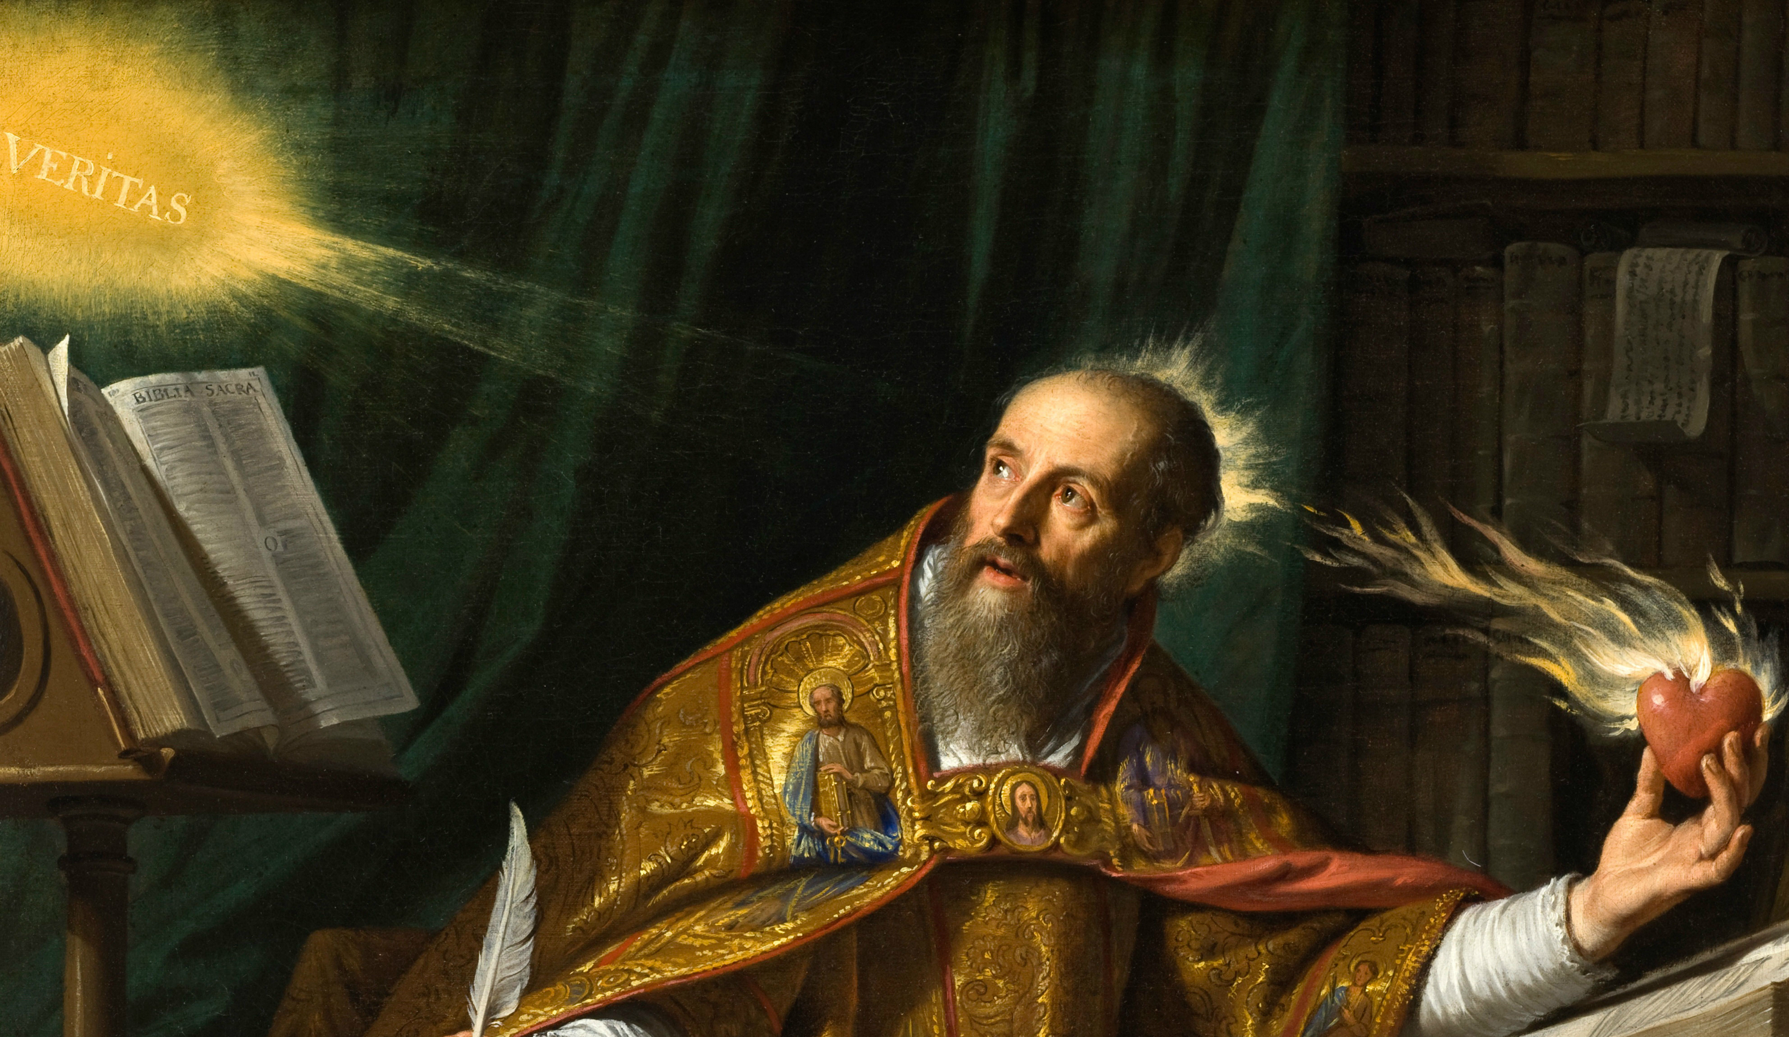
Divine Illumination

Slide 3
Philosophy of Morals

Slide 5
Morals: How we Ought to act/be. Ought: Aimed at Being Good or Being Happy?

Slide 6
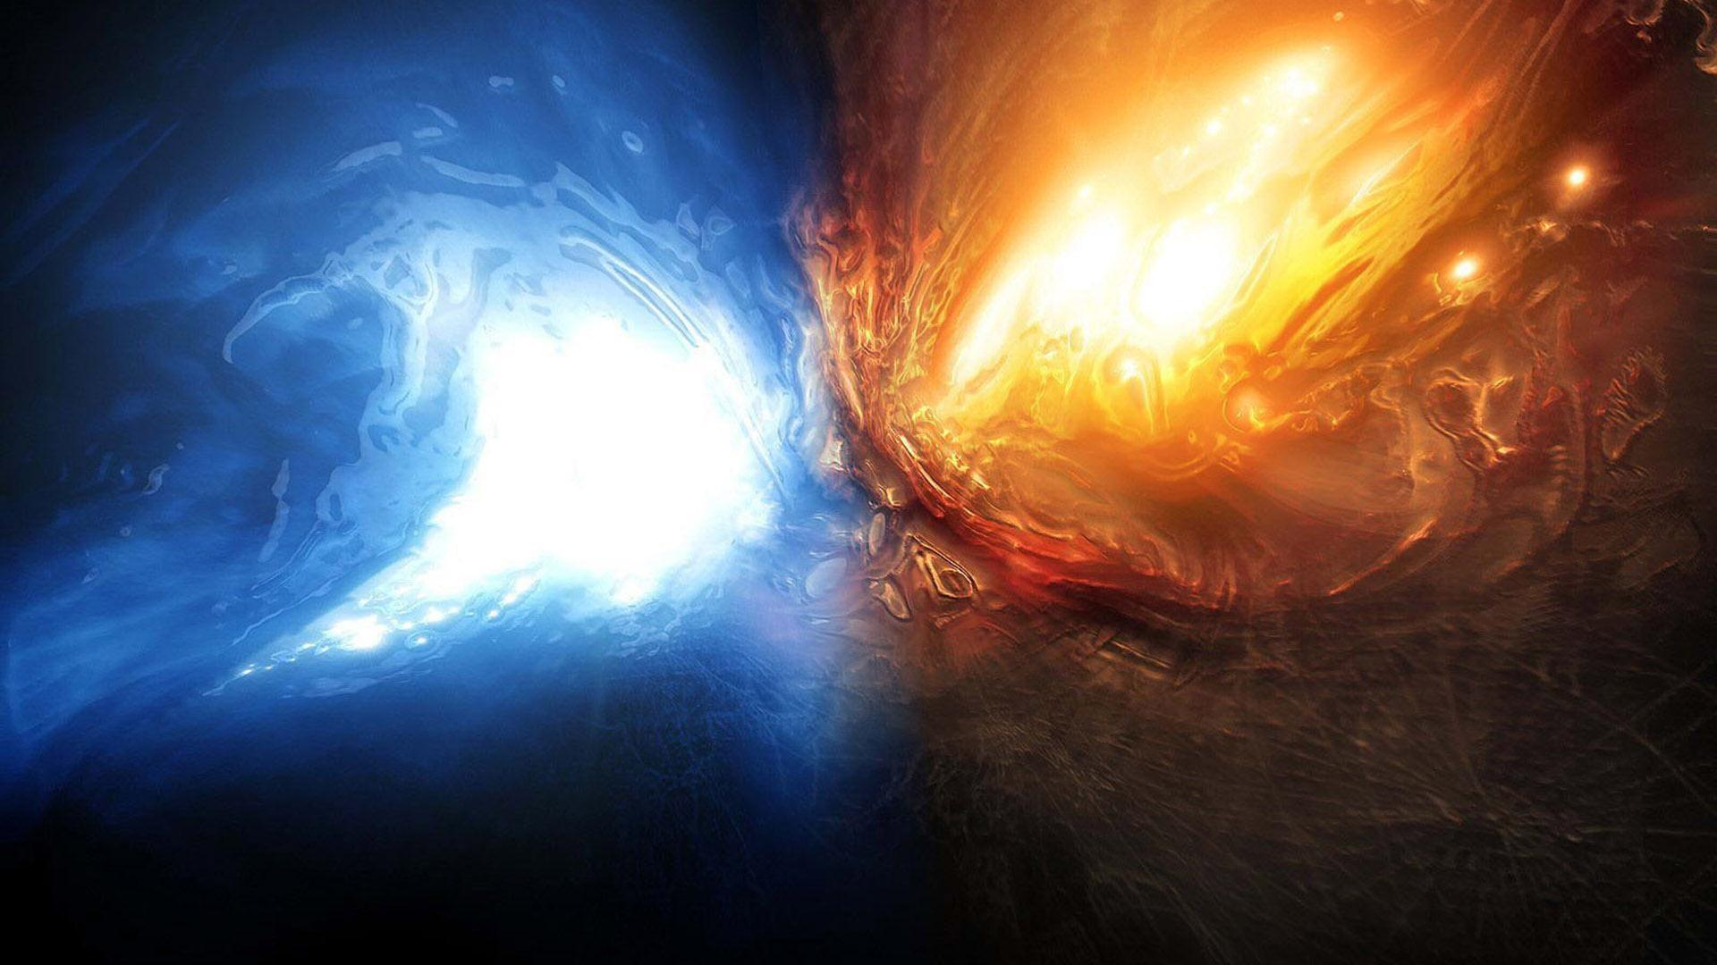
Happiness or Goodness???

Slide 7
Happiness Morals
Consequentialism/ Hedonism/ Utilitarianism.
Egoism.
Virtue Theory/Divine Command?

Slide 8
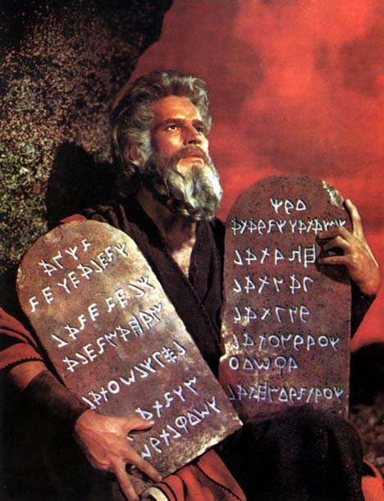
Goodness Morals
Deontology.
Virtue Theory/ Divine Command Theory?

Slide 9
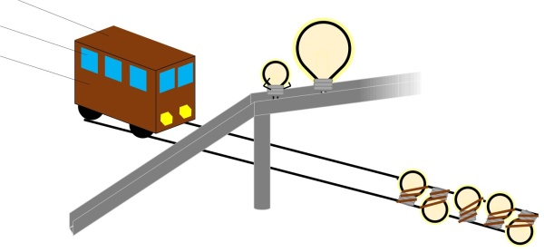

Slide 10
Hold on! Let’s Define our terms.
Ought: What is needed for a thing. [Good or happy in the case of morals]
Being happy: to have what satisfies.
Being good: to have what that thing is.
What is “ought”?
What is “being happy”?
What is “being good”?

Slide 11
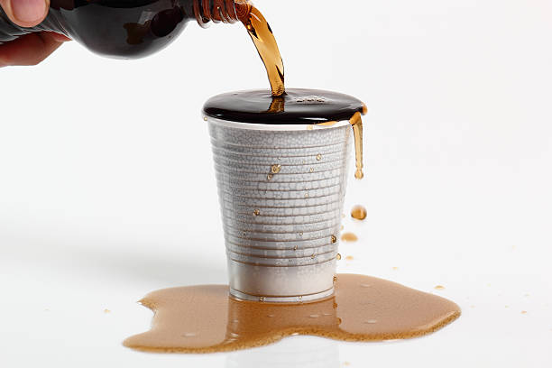
Can a container hold more than its capacity?
Being happy: to have what satisfies (fulfill).
Getting everything you want
No pain (unfulfilled desire) + Full Pleasure.
Peace

Slide 12
Being good: to have what that thing is.
Being good: to fulfill what it is.

Slide 13
Can a container hold more than its capacity?
Being Good=Being Happy
If you are satisfied you fulfill what you are (yourself), and if you fulfill what you are, you are satisfied.

Slide 14
=

Slide 15
Theories of Goodness + happiness. [Eudaimonia]
Virtue/Natural Law Theory
Some Divine Command Theories

Slide 16
Catholic Perspective

Slide 17
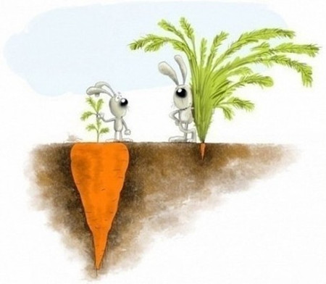
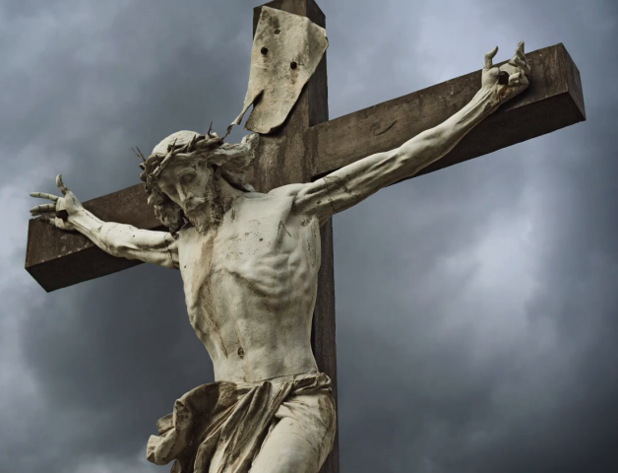
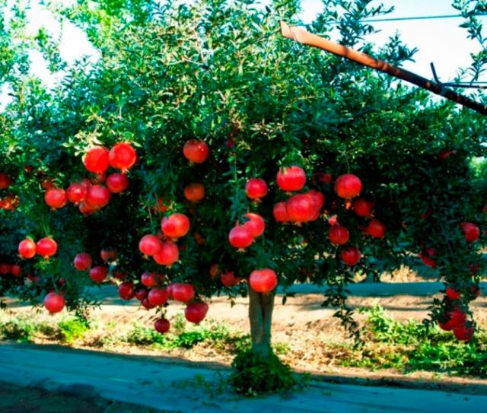
Appearances vs. Reality
By appearance, and on the surface, goodness and happiness are divided.
In the Garden (as in all sin), divided what satisfies us from what we were.
Goodness in what appears unhappy.

Slide 18
Takeaways
Being/Is/Infinite.
Faith and Reason.
Philosophy as Logic

